Slide 1


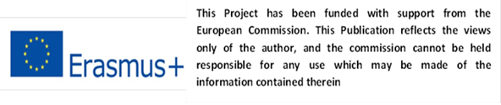

Slide 2
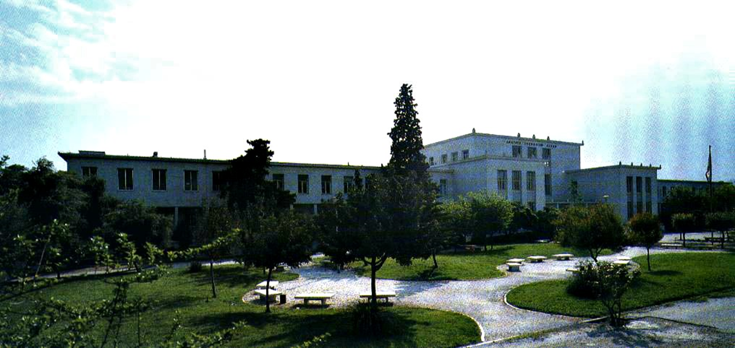
Mr. Lambros Sakkas, vet MSc, PhD student at the AUA

Slide 3
General food laws (principles, hygiene, traceability)
Introduction
Regulation (EC) No 178/2002
EU Food Hygiene Legislation
Food-specific legislation related to traceability

Slide 4
Introduction
White Paper on Food Safety (2000)
“From-Farm-To-Table” approach
New EU food legislation

Slide 5
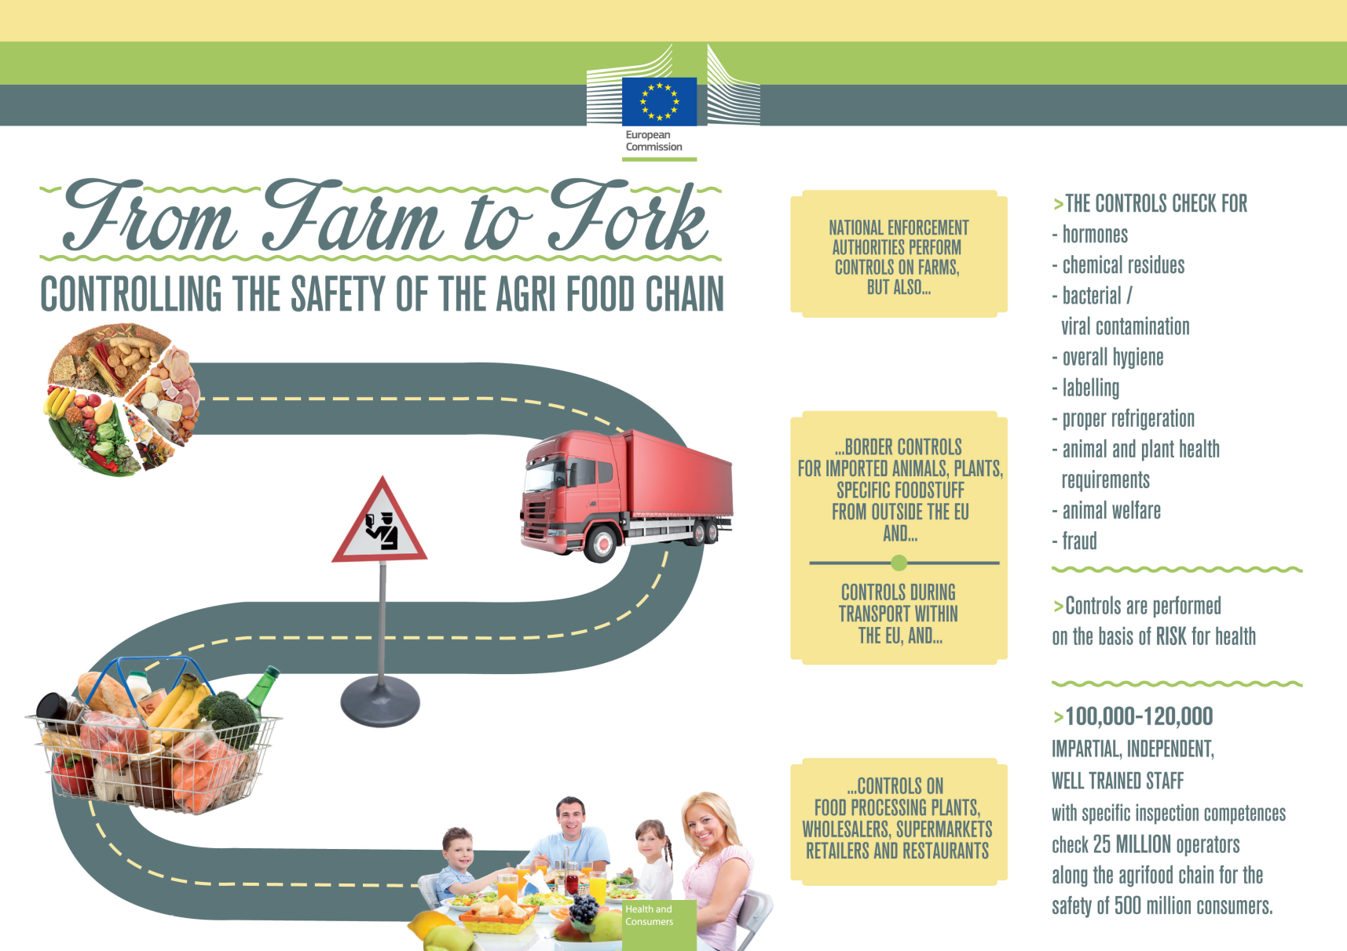
Introduction

Slide 6
Introduction
EU Food Legislation
Regulations → binding legislative acts / applied in their entirety
Directives → legislative acts / countries devise national laws on how to
to achieve the objectives
Implementing acts → legally binding acts / concern procedural elements
https://eur-lex.europa.eu/homepage.html

Slide 7
Regulation (EC) No 178/2002
2002 → Regulation (EC) No 178/2002 → “General Food Law Regulation”
Regulation 178/2002 is the foundation of food and feed law:
  coherent framework for the development of food & feed legislation (EU/national)
  common definitions and general principles, requirements & procedures for food & feed safety at all stages of the production, processing & distribution
  setting of European Food Safety Authority (EFSA)
  main procedures and tools for the management of emergencies & crises as well as the Rapid Alert System for Food and Feed (RASFF)

Slide 8
Regulation (EC) No 178/2002
REGULATION (EC) No 178/2002 OF THE EUROPEAN PARLIAMENT AND OF THE COUNCIL
Of 28 January 2002
“laying down the general principles and requirements of food law, establishing the European Food Safety Authority and laying down procedures in matters of food safety”

Slide 9
Regulation (EC) No 178/2002
Article 1
Aim and scope
1. This Regulation provides the basis for the assurance of a high level of protection of human health and consumers' interest in relation to food, taking into account in particular the diversity in the supply of food including traditional products, whilst ensuring the effective functioning of the internal market. It establishes common principles and responsibilities, the means to provide a strong science base, efficient organizational arrangements and procedures to underpin decision- making in matters of food and feed safety
2. For the purposes of paragraph 1, this Regulation lays down the general principles governing food and feed in general, and food and feed safety in particular, at Community and national level
It establishes the European Food Safety Authority
It lays down procedures for matters with a direct or indirect impact on food and feed safety
3. This Regulation shall apply to all stages of production, processing and distribution of food and feed. It shall not apply to primary production for private domestic use or to the domestic preparation, handling or storage of food for private domestic consumption

Slide 10
Regulation (EC) No 178/2002
Article 2
Definition of food
‘Food’ or ‘foodstuff’: any substance or product, whether processed, partially processed or unprocessed, intended to be, or reasonably expected to be ingested by humans
‘Food’ includes: drink, chewing gum and any substance, including water, intentionally incorporated into the food during its manufacture, preparation or treatment
‘Food’ shall not include: feed, live animals unless they are prepared for placing on the market for human consumption, plants prior to harvesting, medicinal products, cosmetics, tobacco and tobacco products, narcotic or psychotropic substances, residues and contaminants

Slide 11
Regulation (EC) No 178/2002
Article 3
Other definitions
‘food law’: the laws, regulations and administrative provisions governing food in general, and food safety in particular, whether at Community or national level; it covers any stage of production , processing and distribution of food, and also of feed produced for, or fed to, food-producing animals
‘food business’: any undertaking, whether for profit or not and whether public or private, carrying out any of the activities related to any stage of production, processing and distribution of food
‘food business operator’: the natural or legal persons responsible for ensuring that the requirements of food law are met within the food business under their control
‘stages of production, processing and distribution’: any stage, including import, from and including the primary production of a food, up to and including its storage, transport, sale or supply to the final consumer and, where relevant, the importation, production, manufacture, storage, transport, distribution, sale and supply of feed
‘traceability’: the ability to trace and follow a food, feed, food-producing animal or substance intended to be, or expected to be incorporated into a food or feed, through all stages of production, processing and distribution

Slide 12
Regulation (EC) No 178/2002
Article 3
Other definitions
‘risk’: a function of the probability of an adverse health effect and the severity of that effect, consequential to a hazard
‘hazard’: a biological, chemical or physical agent in, or condition of, food or feed with the potential to cause an adverse health effect
‘risk analysis’: a process consisting of three interconnected components: risk assessment, risk management and risk communication
‘risk assessment’: a scientifically based process consisting of four steps: hazard identification, hazard characterisation, exposure assessment and risk characterisation
‘risk management’: the process, distinct from risk assessment, of weighing policy alternatives in consultation with interested parties, considering risk assessment and other legitimate factors, and, if need be, selecting appropriate prevention and control options
‘risk communication’: the interactive exchange of information and opinions throughout the risk analysis process

Slide 13
Regulation (EC) No 178/2002
Article 5
General objectives
  High level of protection of human life & health and the protection of consumers’ interests
  Fair practices in food trade, taking into account animal health/welfare, plant health & the environment
  Free movement of food and feed manufactured and marketed in the EU
  Facilitate global trade of safe feed & safe and wholesome food by taking into account international standards & agreements

Slide 14
Regulation (EC) No 178/2002
Article 6
Risk analysis principle
    Risk assessment → independent, objective & transparent, based on the best available science
    Risk management → select the appropriate actions necessary to prevent, reduce or eliminate the risk
    Risk communication → the interactive exchange of information and opinion throughout risk analysis

Slide 15
Regulation (EC) No 178/2002
Article 7
Precautionary principle: - reasonable grounds for concern that an unacceptable level of risk to health exists - available supporting information & data not sufficiently complete to enable a comprehensive risk assessment
  → Decision makers or risk managers may take measures:
    Proportional
    Non-discriminatory
    Consistent
    Based on the examination of the potential benefits and costs
    Subject to review
    Capable of assigning responsibility for producing the scientific evidence

Slide 16
Regulation (EC) No 178/2002
Article 7
Precautionary principle
Proportionality → tailoring measures to the chosen level of protection
→ a total ban may not be a proportional response to a potential risk in all cases, but it is the only possible response in certain cases
Non-discrimination → comparable situations should not be treated differently
→ different situations should not be treated in the same way
Consistency → measures should be of comparable scope & nature to those already taken when all scientific data are available

Slide 17
Regulation (EC) No 178/2002
Article 7
Precautionary principle
Examining costs & benefits → comparing the overall cost to the Community of action and lack of action, in both the short and long term
→ much broader scope than an economic cost-benefit analysis, considering the efficacy of possible options & their acceptability (the protection of health takes precedence over economic considerations)
Subject to review in the light of new scientific data → measures maintained so long as scientific information is incomplete or inconclusive & the risk is still too high
Assigning responsibility for producing scientific evidence → countries that impose a prior approval requirement on products that they deem dangerous treat them as dangerous, unless and until businesses demonstrate safety

Slide 18
Regulation (EC) No 178/2002
Article 8
Protection of consumers’ interests
Protection of the interests of consumers and provision of a basis for consumers to make informed choices in relation to the foods they consume
Prevention of:
  fraudulent or deceptive practices
  the adulteration of food
  any other practices which may mislead the consumer

Slide 19
Regulation (EC) No 178/2002
Articles 9 & 10
Transparency
    Food safety & protection of consumer interests are of great concern (general public, non-governmental organizations, professional associations, international trading partners & trade organizations) → transparency of decision-making is of paramount importance
    The General Food Law provides for the mechanisms necessary to increase consumer confidence:
      Effective public consultations during the preparation, evaluation & revision of food and feed law
      Obligation on public authorities to inform the general public, in case of reasonable suspicion that a food or feed may present a risk for human or animal health

Slide 20
Regulation (EC) No 178/2002
Article 11
Food and feed imported into the Community
    Food and feed imported shall comply with:
      the relevant requirements of food law or
      conditions recognised by the Community to be at least equivalent or
      where a specific agreement exists between the Community & the exporting country, with agreed requirements
      The traceability provisions of the General Food Law do not have an extra-territorial effect outside the EU → this requirement covers all stages of production, processing and distribution in the EU, namely from the importer up to the retail level
      Traceability is sufficiently fulfilled because the requirement extends to the importer, being able to identify from whom the product was exported in the third country

Slide 21
Regulation (EC) No 178/2002
Article 12
Food and feed exported from the Community
    Food and feed exported or re-exported shall comply with the relevant requirements of food law, unless otherwise requested by the authorities of the importing country (legislation or administrative procedures)
    In other circumstances, except in the case where foods are injurious to health or feeds are unsafe, food and feed can only be exported if the competent authorities of the country of destination have expressly agreed, after having been fully informed of the reasons for which the food or feed concerned could not be placed on the market in the Community
    When there is a bilateral agreement → comply with the agreed provisions
    Rationale → to prevent the “exportation” of crisis

Slide 22
Regulation (EC) No 178/2002
Article 13
International Standards
      Without prejudice to their rights and obligations, the Community and the Member States shall:
      contribute to the development of international technical standards for food/feed & sanitary/ phytosanitary standards
      promote the coordination of work on food/feed standards undertaken by international organisations
      contribute, where relevant and appropriate, to the development of agreements on recognition of the equivalence of specific food and feed-related measures
      give particular attention to the special development, financial and trade needs of developing countries
      promote consistency between international technical standards and food law

Slide 23
Regulation (EC) No 178/2002
Article 14
Food safety requirements
      Food shall not be placed on the market if it is unsafe
      Food shall be deemed to be unsafe if it is considered to be:
        injurious to health or
        unfit for human consumption
      In determining whether any food is unsafe, regard shall be had:
        to the normal conditions of use of the food by the consumer and at each stage of production, processing and distribution, and
        to the information provided to the consumer, including information on the label, or other information generally available to the consumer concerning the avoidance of specific adverse health effects from a particular food or category of foods

Slide 24
Regulation (EC) No 178/2002
Article 14
Food safety requirements
      In determining whether any food is injurious to health, regard shall be had:
        not only to the probable immediate and/or short-term and/or long- term effects of that food on the health of a person consuming it, but also on subsequent generations
        to the probable cumulative toxic effects
        to the particular health sensitivities of a specific category of consumers where the food is intended for that category of consumers
      In determining whether any food is unfit for human consumption, regard shall be had to whether the food is unacceptable for human consumption :
        according to its intended use, for reasons of contamination, whether by extraneous matter or otherwise, or
        through putrefaction, deterioration or decay

Slide 25
Regulation (EC) No 178/2002
Article 14
Food safety requirements
      Where any food which is unsafe is part of a batch, lot or consignment of food of the same class or description, it shall be presumed that all the food in that batch, lot or consignment is also unsafe, unless following a detailed assessment there is no evidence of unsafety
      Food that complies with specific Community provisions shall be deemed to be safe
      Conformity of a food with specific provisions applicable to that food shall not bar the competent authorities from imposing restrictions or requiring its withdrawal from the market where there are reasons to suspect that the food is unsafe
      Where there are no specific Community provisions, food shall be deemed to be safe when it conforms to the specific provisions of national food law

Slide 26
Regulation (EC) No 178/2002
Article 15
Feed safety requirements
      Feed shall not be placed on the market or fed to any food- producing animal if it is unsafe
      Feed shall be deemed to be unsafe for its intended use if it is considered to:
        have an adverse effect on human or animal health, or
        make the food derived from food-producing animals unsafe for human consumption
      Where a feed which has been identified as not satisfying the feed safety requirement is part of a batch, lot or consignment of feed of the same class or description, it shall be presumed that all of the feed in that batch, lot or consignment is so affected, unless following a detailed assessment there is no such evidence

Slide 27
Regulation (EC) No 178/2002
Article 15
Feed safety requirements
      Feed that complies with specific Community provisions shall be deemed to be safe
      Conformity of a feed with specific provisions applicable to that feed shall not bar the competent authorities from imposing restrictions or requiring its withdrawal from the market where there are reasons to suspect that the feed is unsafe
      Where there are no specific Community provisions, food shall be deemed to be safe when it conforms to the specific provisions of national food law

Slide 28
Regulation (EC) No 178/2002
Article 16
Presentation
      Without prejudice to more specific provisions of food law,
      the labelling, advertising and presentation of food or feed, including:
        their shape, appearance or packaging
        the packaging materials used
        the manner in which they are arranged and the setting in which they are displayed and
        the information which is made available about them through whatever medium
      → shall not mislead consumers

Slide 29
Regulation (EC) No 178/2002
Article 17
Responsibilities
      Food and feed business operators at all stages of production, processing and distribution within the businesses under their control shall ensure that foods or feeds satisfy the requirements of food law which are relevant to their activities and shall verify that such requirements are met
      Member States shall enforce food law, & monitor and verify that the relevant requirements of food law are fulfilled by food & feed business operators at all stages of production, processing & distribution
      → maintain a system of official controls & other activities as appropriate to the circumstances (public communication on food & feed safety and risk, food & feed safety surveillance & other monitoring activities covering all stages of production, processing & distribution)
      → lay down the rules on measures & penalties applicable to infringements of food & feed law
      → measures and penalties shall be effective, proportionate and dissuasive

Slide 30
Regulation (EC) No 178/2002
Article 17
Responsibilities
As a food business is best placed to devise a safe system for supplying food/feed & ensuring that the food/feed it supplies is safe, it holds primary legal responsibility for ensuring compliance with food law & in particular food safety (→ fundamental role of food businesses to the farm to table policy, covering all sectors of the food chain)
Defining responsibilities should consider the fact that interactions between producers, manufacturers & distributors are becoming increasingly complex (in many cases primary producers have contractual obligations to manufacturers or distributors to meet specifications which cover quality and/or safety)
Each link in the food chain should take the measures necessary to ensure compliance with food law requirements within the context of its own specific activities (like applying HACCP-type principles)
Where a product is found failing food law requirements, the liability of each link in the chain should be reviewed according to whether or not it has properly fulfilled its own specific responsibilities

Slide 31
Regulation (EC) No 178/2002
Article 18
Traceability
1. The traceability of food, feed, food-producing animals, and any other substance intended to be, or expected to be, incorporated into a food or feed shall be established at all stages of production, processing and distribution
2. Food and feed business operators shall be able to identify any person from whom they have been supplied with a food, a feed, a food-producing animal, or any substance intended to be, or expected to be, incorporated into a food or feed
→ such operators shall have in place systems and procedures which allow for this information to be made available to the competent authorities on demand

Slide 32
Regulation (EC) No 178/2002
Article 18
Traceability
3. Food and feed business operators shall have in place systems and procedures to identify the other businesses to which their products have been supplied → this information shall be made available to the competent authorities on demand
4. Food or feed which is placed on the market or is likely to be placed on the market in the Community shall be adequately labelled or identified to facilitate its traceability, through relevant documentation or information in accordance with the relevant requirements of more specific provisions

Slide 33
Regulation (EC) No 178/2002
Article 18
Traceability / Guidance on the implementation of 178/2002 on General Food Law (2010)
Rationale: Traceability is a way of assisting in having a food safety problem:
It facilitates targeted withdrawal and recall of food, thereby avoiding unnecessary disruption of trade
It enables consumers to be provided with accurate information concerning implicated products, thereby helping to maintain consumer confidence
It facilitates risk assessment by control authorities
Apart from its food safety role, traceability also helps to ensure:
  fair trading amongst operators
  the reliability of information supplied to consumers in terms of substantiating claims made by manufacturers

Slide 34
Regulation (EC) No 178/2002
Article 18
Traceability / Guidance on the implementation of 178/2002 on General Food Law (2010)
Covered operators:
Traceability requirements apply to food business operators at all stages of the food/feed chain, from primary production, food/feed processing to distribution & supply
Brokers are included, regardless of physical possession of the food/feed
Member States should take into account the degree of organisation and continuity of their activities
Where transportation/storage is integrated within a food/feed business, the business as a whole must comply with the provision of traceability principle
→ for the transport unit, maintaining records may be sufficient as other units would maintain records of products received from suppliers

Slide 35
Regulation (EC) No 178/2002
Article 18
Traceability / Guidance on the implementation of 178/2002 on General Food Law (2010)
Impact on food business operators:
The obligation to identify the suppliers and direct recipients of their food/feed is stipulated explicitly
Article 18 is worded in terms of its goal & intended result, rather than in terms of prescribing how that result is to be achieved → allows flexibility
It affects importers who are required to be able to identify from whom the product was exported in the country of origin
Traceability obliges businesses to be able to identify at least the immediate supplier of the product in question & the immediate subsequent recipient, with the exemption of retailers to final consumers / one step back-one step forward

Slide 36
Regulation (EC) No 178/2002
Article 18
Traceability / Guidance on the implementation of 178/2002 on General Food Law (2010)
Implementation of traceability requirements:
Identification of suppliers & customers by food business operators:
  suppliers can be individuals or legal persons
  supermarkets and restaurants are included to customers
  cold store operators and transporters should also keep traceability records
  Internal traceability:
    operators are not expressly compelled to establish a link between incoming & outgoing products
    internal traceability would contribute to more targeted and accurate withdrawals → save costs
    decision is left to food business operators

Slide 37
Regulation (EC) No 178/2002
Article 18
Traceability / Guidance on the implementation of 178/2002 on General Food Law (2010)
Implementation of traceability requirements:
Traceability systems laid down by specific legislation:
  beef labelling, fish labelling, GMOs
  specific regulations laying down marketing & quality standards for certain products
  any other identification system existing within the framework of specific provisions may be used
  Information to be kept → not specified, but operators should keep at least:
    name, address of supplier, and identification of products supplied
    name, address of customer, and identification of products delivered
    date and, where necessary, time of transaction / delivery
    volume, where appropriate, or quantity

Slide 38
Regulation (EC) No 178/2002
Article 18
Traceability / Guidance on the implementation of 178/2002 on General Food Law (2010)
Implementation of traceability requirements:
Time of reaction for traceability data availability:
  “systems” & “procedures” → a structured mechanism able to deliver the needed information upon request
  need to provide the important information, not the format in which it is kept
  the records should be sufficiently organised to enable availability without unduly delay
  Time for keeping records → not specified, but it is suggested:
    highly perishable products (use by date <3 months) → for 6 months after manufacturing/delivery
    products with “best before” date → for the period of the shelf-life plus 6 months
    other products → for 5 years

Slide 39
Regulation (EC) No 178/2002
Article 19
Responsibilities for food: food business operators (withdrawal, recall and notification)
If a food business operator considers or has reason to believe that a food which it has imported, produced, processed, manufactured or distributed is not in compliance with the food safety requirements, it shall :
  immediately initiate procedures to withdraw the food in question from the market where the food has left the immediate control of that operator & inform the competent authorities
  effectively and accurately inform the consumers of the reason for its withdrawal if the product has reached the consumer
  recall from consumers products already supplied to them when other measures are not sufficient to achieve a high level of health protection
  * if the product is removed before being placed on the market or if it is under the immediate control of a particular food business operator, there are no notification obligations

Slide 40
Regulation (EC) No 178/2002
Article 19
A food business operator responsible for retail or distribution activities which do not affect the packaging, labelling, safety or integrity of the food shall :
  initiate procedures to withdraw from the market products not in compliance
  pass on relevant information necessary to trace a food
  A food business operator shall immediately inform the competent authorities:
  if it considers or has reason to believe that a food which it has placed on the market may be injurious to human health
  of the action taken to prevent risks to the final consumer
  A food business operator shall:
    not prevent/discourage any person from cooperating with authorities to reduce/eliminate food risk
    collaborate with the competent authorities on action taken to avoid or reduce risks posed by a food which they supply or have supplied

Slide 41
Regulation (EC) No 178/2002
Article 20
Responsibilities for food: food business operators (withdrawal, recall and notification)
The objectives of this Article are the same as those of Article 19, applied to feed mutatis mutandis
In the context of feed, it is important to take into account that some type of feed in some of its raw state prior to processing is not fit for animal consumption
Mostly similar to those of Article 19, except that Article 20 (1) provides in particular for the destruction of the feed or batch of feed considered as non compliant with the feed safety requirements, unless the competent authority is satisfied otherwise
In the context of feed, the information on withdrawal will concern the users (farmers) of the feed and not consumers

Slide 42
Regulation (EC) No 178/2002
Articles 22-49
European Food Safety Authority (EFSA)
The Regulation sets up an independent agency responsible for scientific advice and support, the European Food Safety Authority (EFSA)
EFSA is a European agency funded by the European Union that operates independently of the European legislative and executive institutions (Commission, Council, Parliament) and EU Member States
EFSA is responsible for risk assessment and also has a duty to communicate its scientific findings to the public
As the risk assessor, EFSA produces scientific opinions and advice that form the basis for European policies and legislation

Slide 43
Regulation (EC) No 178/2002
Articles 50-52
Rapid Alert System for Food and Feed (RASFF)
The Regulation establishes the Rapid Alert System for Food and Feed (RASFF)
It is a rapid alert system for the notification of a direct or indirect risk to human health deriving from food or feed
RASFF is a key tool used to react rapidly to food and feed safety emergencies and incidents, as it enables information to be shared efficiently between its members (EU-28 national food safety authorities, Commission, EFSA, ESA, Norway, Liechtenstein, Iceland and Switzerland)
Thanks to RASFF, many food safety risks had been averted before they could have been harmful to European consumers

Slide 44
Regulation (EC) No 178/2002
Articles 50-52
Rapid Alert System for Food and Feed (RASFF)
Without prejudice to other Community legislation, the Member States shall immediately notify the Commission under the rapid alert system of:
  any measure they adopt which is aimed at restricting the placing on the market or forcing the withdrawal from the market or the recall of food or feed in order to protect human health & requiring rapid action
  any recommendation or agreement with professional operators which is aimed, on a voluntary or obligatory basis, at preventing, limiting or imposing specific conditions on the placing on the market or the eventual use of food or feed on account of a serious risk to human health requiring rapid action
  any rejection, related to a direct or indirect risk to human health, of a batch, container or cargo of food or feed by a competent authority at a border post within the European Union

Slide 45
Commission Regulation (EU) No 16/2011
Commission Regulation (EU) No 16/2011 lays down the implementing measures for the RASFF
It stipulates the duties of the RASFF network members and defines the different types of notifications
It provides that all contact points shall ensure the availability of an on-duty officer reachable outside office hours for emergency communications on a 24-hour/7-day-a-week basis
Before transmitting a notification to all members of the network, the Commission contact point shall verify the RASFF notifications
Any member of the network may request a notification withdrawal or amendments
If the notified product originates from or is distributed to a third country, the Commission shall inform the third country without undue delay
The Regulation introduces exact deadlines for Member States (48 hours) as well as the Commission (24 hours) for transmitting alert notifications

Slide 46
Regulation (EC) No 178/2002
Articles 53-54
Emergency measures
Where food or feed originating in the Community or imported presents a serious and uncontainable risk to human health, animal health or the environment, the Commission can put in place protective measures, following an opinion from the Standing Committee on Plants, Animals, Food and Feed (PAFF Committee, established in Article 58) and:
  suspend the placing on the market or use of products originating from the EU
  suspend imports of products originating from third countries
Such action can be initiated by the Commission itself, or be requested by a Member State
However, if the Commission does not act after having been informed of the existence of a risk, the EU country concerned may take temporary protective measures
Within 10 working days, the Commission must refer the matter to the PAFF Committee

Slide 47
Regulation (EC) No 178/2002
Articles 55-57
Crisis management
A general plan for crisis management shall be followed in cases of direct or indirect risks to human health deriving from food & feed which:
  are not likely to be prevented, eliminated or reduced to an acceptable level by provisions in place or
  cannot adequately be managed by defined emergency measures
The general plan for crisis management is established by Decision 2004/478/EC
It also specifies the crisis situations involving a serious direct or indirect risk to human health

Slide 48
Regulation (EC) No 178/2002
Articles 55-57
Crisis management
In the case of a serious risk, the Commission must immediately set up a crisis unit:
  supported scientifically & technically by EFSA
  responsible for collecting & evaluating all relevant information & identifying the options available for preventing, eliminating or reducing the risk to human health
Decision 2004/478/EC also lays down management procedures where the risk is potential but could evolve into a serious risk → a crisis unit will not be set up but adequate provisions will be made to ensure effective management

Slide 49
Fitness Check of Regulation (EC) No 178/2002
Fitness Checks provide an evidence-based critical analysis of whether Union actions are proportionate to their objectives and delivering as expected
In 2018 Fitness Check on General Food Law was completed, assessing whether the legislative framework introduced by the Regulation for the entire food and feed sector is 'fit for purpose' and whether it captures and reflects policy trends of today
Main findings of the Fitness Check on the General Food Law :
  The Regulation is still relevant today with respect to the current trends: growth and competitiveness and increased globalization
  Overall, it has achieved its core objectives, namely high protection of human health and consumers’ interests and the smooth functioning of the internal market
  No systemic failures have been identified. Nevertheless, the GFL is less adequate to address new challenges like food sustainability in general, and more specifically, food waste

Slide 50
Revision of Regulation (EC) No 178/2002
In April 2018 the European Commission officially proposed a targeted revision of the General Food Law Regulation, drawing also on the Commission's Fitness Check
The proposal aims to:
  give citizens greater access to information submitted to the European Food Safety Authority (EFSA) on approvals concerning the agri-food chain
  provide the possibility for additional studies to be requested by the Commission and will involve Member States' scientists more closely in approval procedures
  The proposal refers to revision of the Regulation coupled to revision of sectoral legislation to strengthen transparency in the area of:
    GMOs & novel foods
    feed & food additives, smoke flavourings, food enzymes & flavourings
    food contact materials & plant protection products

Slide 51
EU Food Hygiene Legislation
EU Rules regarding Food Hygiene (“hygiene package”) cover all stages of the production, processing, distribution and placing on the market of food intended for human consumption
Rules on hygiene of foodstuffs were adopted in April 2004 by the European Parliament and the Council and they became applicable on 1 January 2006
They merged, harmonised and simplified detailed and complex hygiene requirements previously contained in a number of Council Directives

Slide 52
EU Food Hygiene Legislation
These rules are provided for in the following key acts:
  Regulation (EC) 852/2004 on the hygiene of foodstuffs
  Regulation (EC) 853/2004 laying down specific hygiene rules for food of animal origin
  Regulation (EC) 854/2004 laying down specific rules for the organisation of official controls on products of animal origin intended for human consumption
  Directive 2004/41/EC repealing certain Directives concerning food hygiene and health conditions for the production and placing on the market of certain products of animal origin intended for human consumption and amending Council Directives 89/662/EEC and 92/118/EEC and Council Decision 95/408/EC

Slide 53
EU Food Hygiene Legislation
Main principles taken into account by the hygiene rules:
  Primary responsibility for food safety borne by the food business operator
  Food safety ensured throughout the food chain, starting with primary production
  General implementation of procedures based on HACCP principles
  Application of basic common hygiene requirements, possibly further specified for certain categories of food
  Registration or approval for certain food establishments
  Development of guides to good practice for hygiene or for the application of HACCP principles as a valuable instrument to aid food business operators at all levels of the food chain to comply with the new rules
  Flexibility provided for food produced in remote areas & for traditional production & methods

Slide 54
EU Food Hygiene Legislation
  Selected guides provided by the European Commission
  Guidelines on minimum recommendations for official laboratory appointed for the detection of Trichinella in meat
  Guidance on food safety management systems for certain small food retailers
  Commission notice on addressing microbiological risks in fresh fruits and vegetables at primary production through good hygiene
  Commission Notice on Food Safety Management Systems (FSMS), including HACCP
  Guidance document on hygiene of food of animal origin
  Guidance document on rules on food hygiene and official controls
  Guidance document on the hygiene of all food
  Illustrative Guidance on import conditions for composite products

Slide 55
Regulation (EC) No 852/2004
Regulation (EC) No 852/2004 of the European Parliament and of the Council
“on the hygiene of foodstuffs”
Article 1
Scope
This Regulation lays down general rules for food business operators on the hygiene of foodstuffs, taking particular account of the following principles:
Primary responsibility for food safety rests with the food business operator
It is necessary to ensure food safety throughout the food chain, starting with primary production

Slide 56
Regulation (EC) No 852/2004
It is important, for food that cannot be stored safely at ambient temperatures, particularly frozen food, to maintain the cold chain
General implementation of procedures based on the HACCP principles, together with the application of good hygiene practice, should reinforce food business operators' responsibility
Guides to good practice are a valuable instrument to aid food business operators at all levels of the food chain with compliance with food hygiene rules and with the application of the HACCP principles
It is necessary to establish microbiological criteria and temperature control requirements based on a scientific risk assessment
It is necessary to ensure that imported foods are of at least the same hygiene standard as food produced in the Community, or are of an equivalent standard

Slide 57
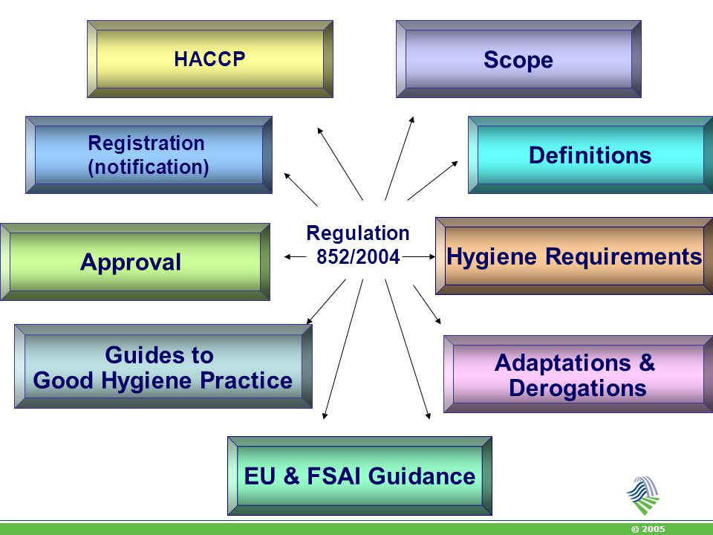
Regulation (EC) No 852/2004

Slide 58
Regulation (EC) No 852/2004
Article 1
Scope
This Regulation shall apply to all stages of production, processing and distribution of food and to exports, and without prejudice to more specific requirements relating to food hygiene
The Regulation shall not apply to:
primary production for private domestic use
the domestic preparation, handling or storage of food for private domestic consumption
the direct supply, by the producer, of small quantities of primary products to the final consumer or to local retail establishments (national rules shall be established)
collection centres & tanneries

Slide 59
Regulation (EC) No 852/2004
Article 2
Definitions
‘food hygiene’ or ‘hygiene’: the measures & conditions necessary to control hazards & to ensure fitness for human consumption of a foodstuff taking into account its intended use
‘establishment’: any unit of a food business
‘equivalent’: in respect of different systems, capable of meeting the same objectives
‘potable water’: water meeting the minimum requirements laid down in Council Directive 98/83/EC
‘clean water:’ clean seawater and fresh water of a similar quality
‘wrapping’: the placing of a foodstuff in a wrapper or container in direct contact with the foodstuff concerned, & the wrapper or container itself
‘packaging’: the placing of one or more wrapped foodstuffs in a 2nd container, & the latter container itself
‘processing’: any action that substantially alters the initial product, including heating, smoking, curing, maturing, drying, marinating, extraction, extrusion or a combination of those processes
‘unprocessed products’: foodstuffs that have not undergone processing; divided, parted severed, sliced, boned, minced, skinned, ground, cut, cleaned, trimmed, husked, milled, chilled, frozen, deep-frozen, thawed products

Slide 60
Regulation (EC) No 852/2004
Article 3
General obligation for food business operators
This Regulation shall apply to all stages of production, processing & distribution of food & to exports, & without prejudice to more specific requirements relating to food hygiene
Article 4
General obligation for food business operators
compliance with microbiological criteria for foodstuffs
procedures necessary to meet targets set to achieve the objectives of this Regulation
compliance with temperature control requirements for foodstuffs
maintenance of the cold chain
sampling & analysis (use of equivalent methods where not specified)

Slide 61
Regulation (EC) No 852/2004
Article 5
Hazard Analysis and Critical Control Points
Food business operators (after primary production & associated operations) shall put in place, implement & maintain a permanent procedure or procedures based on the HACCP principles:
identifying any hazards that must be prevented, eliminated or reduced to acceptable levels
identifying the CCPs at the steps at which control is essential to prevent or eliminate a hazard or to reduce it to acceptable levels
establishing critical limits at CCPs which separate acceptability from unacceptability for the prevention, elimination or reduction of identified hazards
establishing & implementing effective monitoring procedures at CCPs
establishing corrective actions when monitoring indicates that a CCP is not under control
establishing procedures, which shall be carried out regularly, to verify that 1-5 measures are working effectively
establishing documents & records commensurate with the nature & size of the food business to demonstrate the effective application of 1-6 measures

Slide 62
Regulation (EC) No 852/2004
Article 5
Hazard Analysis and Critical Control Points
When any modification is made in the product, process, or any step, food business operators shall review the procedure & make the necessary changes
Food business operators shall:
  provide the competent authority with evidence of their compliance
  ensure that any documents describing the procedures developed are up-to-date at all times
  retain any other documents and records for an appropriate period

Slide 63
Regulation (EC) No 852/2004
ANNEX I: Primary production
Part A: General hygiene provisions for primary production and associated operations
Scope
This Annex applies to primary production & the following associated operations:
the transport, storage & handling of primary products at the place of production, provided that this does not substantially alter their nature
the transport of live animals, where this is necessary to achieve the objectives of this Regulation
in the case of products of plant origin, fishery products and wild game, transport operations to deliver primary products, the nature of which has not been substantially altered, from the place of production to an establishment

Slide 64
Regulation (EC) No 852/2004
Hygiene provisions
As far as possible, food business operators are to ensure that primary products are protected against contamination, having regard to any processing that they will subsequently undergo
Food business operators are to comply with appropriate Community & national legislative provisions relating to the control of hazards, including:
  measures to control contamination from the air, soil, water, feed, fertilisers, veterinary medicinal products, plant protection products & biocides & the storage, handling & disposal of waste and
  measures relating to animal health & welfare and plant health that have implications for human health, including programmes for the monitoring & control of zoonoses & zoonotic agents

Slide 65
Regulation (EC) No 852/2004
Hygiene provisions
Food business operators rearing, harvesting or hunting animals or producing primary products of animal origin are to take adequate measures, as appropriate:
  to keep facilities clean and, where necessary to disinfect them appropriately
  to keep clean &, where necessary, to disinfect equipment, containers, crates, vehicles & vessels
  to ensure the cleanliness of animals going to slaughter and, where necessary, production animals
  to use potable water or clean water
  to ensure that staff handling foodstuffs are in good health & undergo training on health risks
  to prevent animals & pests from causing contamination
  to store & handle waste & hazardous substances so as to prevent contamination
  to prevent the introduction & spread of contagious diseases transmissible to humans through food
  to use feed additives & veterinary medicinal products as required by legislation

Slide 66
Regulation (EC) No 852/2004
Hygiene provisions
Food business operators producing or harvesting plant products are to take adequate measures, as appropriate:
  to keep clean &, where necessary, to disinfect facilities, equipment, containers, crates, vehicles, vessels
  to ensure, cleanliness & hygienic production, transport & storage conditions for plant products
  to use potable water or clean water
  to ensure that staff handling foodstuffs are in good health & undergo training on health risks
  to prevent animals & pests from causing contamination
  to store & handle wastes & hazardous substances so as to prevent contamination
  to take account of the results of any relevant analyses that have importance to human health
  to use plant protection products & biocides as required by legislation
  Operators are to take appropriate remedial action when informed of problems identified during official controls

Slide 67
Regulation (EC) No 852/2004
Record-keeping
Food business operators are to keep and retain records relating to measures put in place to control hazards in an appropriate manner and for an appropriate period, & to make them available to the competent authority and receiving food business operators on request
Operators rearing animals or producing primary products of animal origin are, in particular, to keep records on:
  the nature & origin of feed
  veterinary medicinal products or other treatments, dates of administration & withdrawal periods
  the occurrence of diseases that may affect the safety of products
  the results of any analyses carried out on samples taken from animals or other samples taken for diagnostic purposes, that have importance for human health
  any relevant reports on checks carried out on animals or products

Slide 68
Regulation (EC) No 852/2004
Record-keeping
Food business operators producing or harvesting plant products are, in particular, to keep records on:
  any use of plant protection products & biocides
  any occurrence of pests or diseases that may affect the safety of products of plant origin
  the results of any relevant analyses carried out on samples taken from plants or other samples that have importance to human health
  The food business operators may be assisted by other persons, such as veterinarians, agronomists & farm technicians, with the keeping of records

Slide 69
Regulation (EC) No 852/2004
ANNEX II: General hygiene requirements for all food business operators
Chapter I: General requirements for food premises
Food premises are to be kept clean & maintained in good repair & condition
The layout, design, construction, siting & size of food premises are to:
  permit adequate maintenance, cleaning and/or disinfection, avoid or minimise contamination by air, and provide adequate working space to allow for the hygienic performance of all operations
  be such as to protect against the accumulation of dirt, contact with toxic materials, the shedding of particles into food & the formation of condensation or undesirable mould on surfaces
  permit good food hygiene practices, including protection against contamination & pest control
  where necessary, provide suitable temperature-controlled handling & storage conditions of sufficient capacity for maintaining foodstuffs at appropriate temperatures & designed to allow those temperatures to be monitored &, where necessary, recorded

Slide 70
Regulation (EC) No 852/2004
Chapter I: General requirements for food premises
An adequate number of flush lavatories are to be available & connected to an effective drainage system → lavatories are not to open directly into rooms in which food is handled
An adequate number of washbasins is to be available, suitably located & designated for cleaning hands, provided with hot and cold running water, materials for cleaning hands and for hygienic drying → where necessary, the facilities for washing food are to be separate from the hand-washing facility
There is to be suitable & sufficient means of natural or mechanical ventilation → mechanical airflow from a contaminated area to a clean area is to be avoided
Ventilation systems are to be so constructed as to enable filters & other parts requiring cleaning or replacement to be readily accessible

Slide 71
Regulation (EC) No 852/2004
Chapter I: General requirements for food premises
Sanitary conveniences are to have adequate natural or mechanical ventilation
Food premises are to have adequate natural and/or artificial lighting
Drainage facilities are to be adequate for the purpose intended
They are to be designed & constructed to avoid the risk of contamination
Where drainage channels are fully or partially open, they are to be so designed as to ensure that waste does not flow from a contaminated area towards or into a clean area, in particular an area where foods likely to present a high risk to the final consumer are handled
Where necessary, adequate changing facilities for personnel are to be provided
Cleaning agents & disinfectants are not to be stored in areas where food is handled

Slide 72
Regulation (EC) No 852/2004
Chapter II: Specific requirements in rooms where foodstuffs are prepared, treated or processed
In rooms where food is prepared, treated or processed the design & layout are to permit good food hygiene practices, including protection against contamination between and during operations. In particular:
  Floor surfaces are to be maintained in a sound condition & be easy to clean & to disinfect Floor materials are to be impervious, non-absorbent, washable and non-toxic (or equivalent) Where appropriate, floors are to allow adequate surface drainage
  Wall surfaces are to be maintained in a sound condition & be easy to clean & to disinfect Wall materials are to be impervious, non-absorbent, washable & non-toxic (or equivalent) A smooth surface up to a height appropriate for the operations is required
  Ceilings & overhead fixtures are to be constructed & finished so as to prevent the accumulation of dirt & to reduce condensation, the growth of undesirable mould & the shedding of particles

Slide 73
Regulation (EC) No 852/2004
Chapter II: Specific requirements in rooms where foodstuffs are prepared, treated or processed
  Windows & other openings are to be constructed to prevent the accumulation of dirt Those which can be opened to the outside environment are, where necessary, to be fitted with insect-proof screens which can be easily removed for cleaning Where open windows would result in contamination, windows are to remain closed during production
  Doors are to be easy to clean and, where necessary, to disinfect This will require the use of smooth and non-absorbent surfaces (or equivalent)
  Surfaces (including surfaces of equipment) in areas where foods are handled and in particular those in contact with food are to be maintained in a sound condition and be easy to clean and, where necessary, to disinfect This will require the use of smooth, washable corrosion-resistant and non-toxic materials (or equivalent)

Slide 74
Regulation (EC) No 852/2004
Chapter II: Specific requirements in rooms where foodstuffs are prepared, treated or processed
Adequate facilities are to be provided, where necessary, for the cleaning, disinfecting & storage of working utensils & equipment These facilities are to be constructed of corrosion-resistant materials, be easy to clean & have an adequate supply of hot and cold water
Adequate provision is to be made, where necessary, for washing food Every sink or other such facility provided for the washing of food is to have an adequate supply of hot and/or cold potable water consistent with the requirements of Chapter VII and be kept clean &, where necessary, disinfected

Slide 75
Regulation (EC) No 852/2004
Chapter III: Requirements for movable and/or temporary premises (such as marquees, market stalls, mobile sales vehicles), premises used primarily as a private dwelling-house but where foods are regularly prepared for placing on the market and vending machines
Premises & vending machines are, as applicable, to be so sited, designed, constructed & kept clean & maintained in good repair & condition as to avoid contamination (animal, pests)
In particular, where necessary:
  Appropriate facilities are to be available to maintain adequate personal hygiene
  Surfaces in contact with food are to be in a sound condition and be easy to clean &, where necessary, to disinfect This will require the use of smooth, washable, corrosion-resistant & non-toxic materials (or equivalent)
  Adequate provision is to be made for the cleaning &, where necessary, disinfecting of working utensils & equipment

Slide 76
Regulation (EC) No 852/2004
Chapter III: Requirements for movable and/or temporary premises (such as marquees, market stalls, mobile sales vehicles), premises used primarily as a private dwelling-house but where foods are regularly prepared for placing on the market and vending machines
  Where foodstuffs are cleaned as part of the food business' operations, adequate provision is to be made for this to be undertaken hygienically
  An adequate supply of hot and/or cold potable water is to be available
  Adequate arrangements and/or facilities for the hygienic storage & disposal of hazardous and/or inedible substances and waste (whether liquid or solid) are to be available
  Adequate facilities and/or arrangements for maintaining & monitoring suitable food temperature conditions are to be available
  Foodstuffs are to be so placed as to avoid the risk of contamination as applicable

Slide 77
Regulation (EC) No 852/2004
Chapter IV: Transport
Conveyances and/or containers used for transporting foodstuffs are to be kept clean & maintained in good repair & condition to protect foodstuffs from contamination & are, where necessary, to be designed & constructed to permit adequate cleaning and/or disinfection
Receptacles in vehicles and/or containers are not to be used for transporting anything other than foodstuffs where this may result in contamination
Where conveyances and/or containers are used for transporting anything in addition to foodstuffs or for transporting different foodstuffs at the same time, there is, where necessary, to be effective separation of products

Slide 78
Regulation (EC) No 852/2004
Chapter IV: Transport
Bulk foodstuffs in liquid, granulate or powder form are to be transported in receptacles and/or containers/tankers reserved for the transport of foodstuffs Such containers are to be marked in a clearly visible and indelible fashion, in one or more Community languages, to show that they are used for the transport of foodstuffs, or are to be marked ‘for foodstuffs only’
Where conveyances and/or containers have been used for transporting anything other than foodstuffs or for transporting different foodstuffs, there is to be effective cleaning between loads to avoid the risk of contamination
Foodstuffs in conveyances and/or containers are to be so placed and protected as to minimise the risk of contamination
Where necessary, conveyances and/or containers used for transporting food stuffs are to be capable of maintaining foodstuffs at appropriate temperatures & allow temperature monitoring

Slide 79
Regulation (EC) No 852/2004
Chapter V: Equipment requirements
All articles, fittings & equipment with which food comes into contact are to:
  be effectively cleaned & disinfected at a sufficient frequency to avoid any risk of contamination
  be so constructed, be of such materials and be kept in such good order, repair & condition as to minimise any risk of contamination
  with the exception of non-returnable containers & packaging, be so constructed, be of such materials & be kept in such good order, repair & condition as to enable them to be kept clean &, where necessary, to be disinfected
  be installed in such a manner as to allow adequate cleaning of the equipment & surrounding area
  Where necessary, equipment is to be fitted with any appropriate control device to guarantee fulfilment of this Regulation's objectives
  Where chemical additives have to be used to prevent corrosion of equipment and containers, they are to be used in accordance with good practice

Slide 80
Regulation (EC) No 852/2004
Chapter VI: Food waste
Food waste, non-edible by-products & other refuse are to be removed from rooms where food is present as quickly as possible, so as to avoid their accumulation
Food waste & other refuse are to be deposited in closable containers (or equivalent), which are to be of an appropriate construction, kept in sound condition, be easy to clean &, where necessary, to disinfect
Adequate provision is to be made for the storage & disposal of food waste & other refuse Refuse stores are to be designed and managed in such a way as to enable them to be kept clean &, where necessary, free of animals & pests
All waste is to be eliminated in a hygienic & environmentally friendly way in accordance with Community legislation & is not to constitute a direct or indirect source of contamination

Slide 81
Regulation (EC) No 852/2004
Chapter VII: Water supply
i) There is to be an adequate supply of potable water, which is to be used whenever necessary to ensure that foodstuffs are not contaminated
ii) Clean water may be used with whole fishery products; clean seawater may be used with live bivalve molluscs, echinoderms, tunicates & marine gastropods; clean water may also be used for external washing When clean water is used, adequate facilities & procedures are to be available for its supply to ensure that such use is not a source of contamination for the foodstuff
Where non-potable water is used, for example for fire control, steam production, refrigeration & other similar purposes, it is to circulate in a separate duly identified system Non-potable water is not to connect with, or allow reflux into, potable water systems

Slide 82
Regulation (EC) No 852/2004
Chapter VII: Water supply
Recycled water used in processing or as an ingredient is not to present a risk of contamination It is to be of the same standard as potable water, unless the competent authority is satisfied that the quality of the water cannot affect the foodstuff wholesomeness in its finished form
Ice which comes into contact with food or which may contaminate food is to be made from potable water or, when used to chill whole fishery products, clean water It is to be made, handled & stored under conditions that protect it from contamination
Steam used directly in contact with food is not to contain any substance that presents a hazard to health or is likely to contaminate the food
Where heat treatment is applied to foodstuffs in hermetically sealed containers it is to be ensured that water used to cool the containers after heat treatment is not a source of contamination for the foodstuff

Slide 83
Regulation (EC) No 852/2004
Chapter VIII: Personal hygiene
Every person working in a food-handling area is to maintain a high degree of personal cleanliness and is to wear suitable, clean &, where necessary, protective clothing
No person suffering from, or being a carrier of a disease likely to be transmitted through food or afflicted, for example, with infected wounds, skin infections, sores or diarrhoea is to be permitted to handle food or enter any food-handling area in any capacity if there is any likelihood of direct or indirect contamination Any person so affected & employed in a food business & who is likely to come into contact with food is to report immediately the illness or symptoms, & if possible their causes, to the food business operator

Slide 84
Regulation (EC) No 852/2004
Chapter IX: Provisions applicable to foodstuffs
A food business operator is not to accept raw materials or ingredients or any other material used in processing products, if they are known to be, or might reasonably be expected to be contaminated with parasites, pathogenic microorganisms or toxic, decomposed or foreign substances to such an extent that, even after hygienically applied normal sorting and/or preparatory or processing procedures, the final product would be unfit for human consumption
Raw materials & all ingredients stored in a food business are to be kept in appropriate conditions designed to prevent harmful deterioration & protect them from contamination
At all stages of production, processing & distribution, food is to be protected against any contamination likely to render the food unfit for human consumption, injurious to health or contaminated in such a way that it would be unreasonable to expect it to be consumed
Adequate procedures are to be in place to control pests & to prevent domestic animals from having access to places where food is prepared, handled or stored

Slide 85
Regulation (EC) No 852/2004
Chapter IX: Provisions applicable to foodstuffs
Raw materials, ingredients, intermediate products & finished products likely to support the reproduction of pathogenic micro-organisms or the formation of toxins are not to be kept at temperatures that might result in a risk to health The cold chain is not to be interrupted, but limited periods outside temperature control are permitted, to accommodate the practicalities of handling during preparation, transport, storage, display & service of food, provided that it does not result in a risk to health Food businesses manufacturing, handling & wrapping processed foodstuffs are to have suitable rooms, large enough for the separate storage of raw materials from processed material & sufficient separate refrigerated storage
Where foodstuffs are to be held or served at chilled temperatures they are to be cooled as quickly as possible following the heat-processing or final preparation stage, to a temperature which does not result in a risk to health

Slide 86
Regulation (EC) No 852/2004
Chapter IX: Provisions applicable to foodstuffs
The thawing of foodstuffs is to be undertaken in such a way as to minimise the risk of growth of pathogenic microorganisms or the formation of toxins in the foods During thawing, foods are to be subjected to temperatures that would not result in a risk Where run-off liquid from the thawing process may present a risk to health it is to be adequately drained Following thawing, food is to be handled in such a manner as to minimise the risk of growth of pathogenic microorganisms or the formation of toxins
Hazardous and/or inedible substances, including animal feed, are to be adequately labelled and stored in separate and secure containers

Slide 87
Regulation (EC) No 852/2004
Chapter X: Provisions applicable to the wrapping and packaging of foodstuffs
Materials used for wrapping & packaging are not to be a source of contamination
Wrapping materials are to be stored in such a manner that they are not exposed to a risk of contamination
Wrapping & packaging operations are to be carried out so as to avoid contamination of the products Where appropriate & in particular in the case of cans & glass jars, the integrity of the container's construction & its cleanliness is to be assured
Wrapping & packaging material re-used for foodstuffs is to be easy to clean &, where necessary, to disinfect

Slide 88
Regulation (EC) No 852/2004
Chapter XI: Heat treatment of food placed in hermetically sealed containers
Any heat treatment process used to process an unprocessed product or to process further a processed product is:
a) to raise every party of the product treated to a given temperature for a given period of time
& b) to prevent the product from becoming contaminated during the process
To ensure that the process employed achieves the desired objectives, food business operators are to check regularly the main relevant parameters (particularly temperature, pressure, sealing and microbiology), including by the use of automatic devices
The heat process used should conform to an internationally recognised standard

Slide 89
Regulation (EC) No 852/2004
Chapter XII: Training
Food business operators are to ensure:
that food handlers are supervised & instructed and/or trained in food hygiene matters in relation to their work activity
that those responsible for the development & maintenance of the HACCP-based procedure or for the operation of relevant guides have received adequate training in the application of the HACCP principles
compliance with any requirements of national law concerning training programmes for persons working in certain food sectors

Slide 90
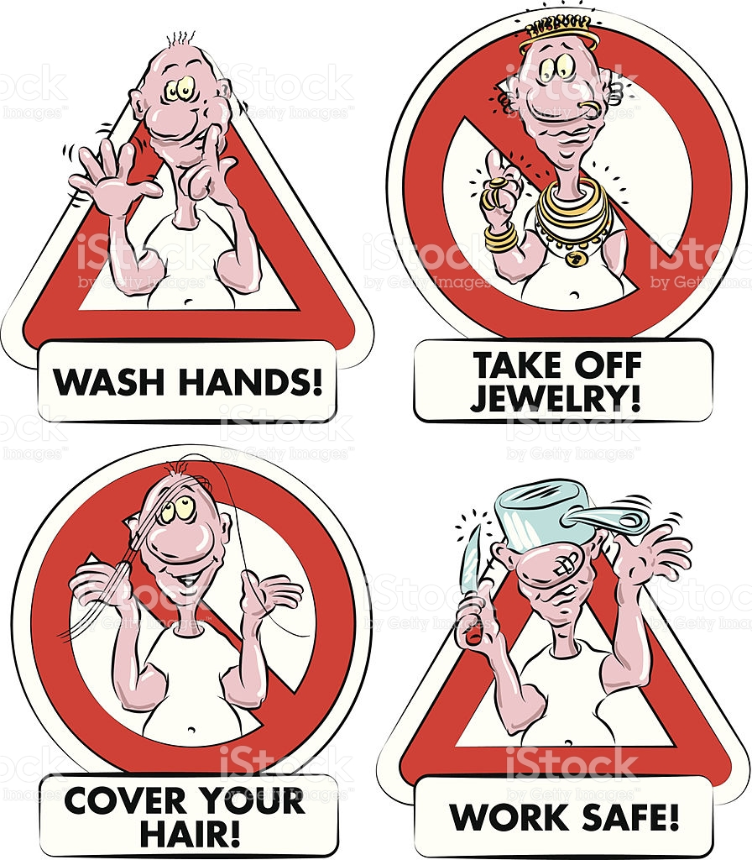
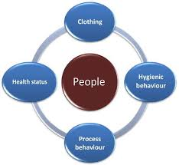
Regulation (EC) No 852/2004

Slide 91
Regulation (EC) No 853/2004
Regulation (EC) No 853/2004 of the European Parliament and of the Council
“laying down specific hygiene rules for food of animal origin”
Article 1
Scope
This Regulation lays down specific rules on the hygiene of food of animal origin for food business operators, which supplement those laid down by Regulation (EC) No 852/2004
They shall apply to unprocessed and processed products of animal origin
Unless expressly indicated to the contrary, this Regulation shall not apply to food containing both products of plant origin and processed products of animal origin

Slide 92
Regulation (EC) No 853/2004
Article 1
Scope
The Regulation shall not apply in relation to:
primary production for private domestic use
the domestic preparation, handling or storage of food for private domestic consumption
the direct supply, (i) by the producer, of small quantities of primary products or (ii) small quantities of meat from poultry and lagomorphs slaughtered on the farm or (iii) small quantities of wild game (by the hunter) to the final consumer or to local retail establishments (national rules established)
retail, unless expressly indicated to the contrary
This Regulation shall apply without prejudice to:
relevant animal and public health rules
animal welfare requirements
requirements concerning animal identification & the traceability of products of animal origin

Slide 93
Regulation (EC) No 853/2004
Article 5
Health and identification marking
Food business operators shall not place on the market a product of animal origin handled in an establishment subject to approval in accordance with this Regulation unless it has either:
  a health mark applied in accordance with Regulation (EC) No 854/2004 or
  when that Regulation does not provide for the application of a health mark, an identification mark applied in accordance with Annex II, Section I, of this Regulation
Food business operators may apply an identification mark to a product of animal origin only if the product has been manufactured in accordance with this Regulation in establishments meeting the requirements of Article 4 concerning registration and approval
Food business operators may not remove a health mark applied in accordance with Regulation (EC) No 854/2004 from meat unless they cut or process it or work upon it in another manner

Slide 94
Regulation (EC) No 853/2004
ANNEX I: Definitions
‘Products of animal origin’ means:
food of animal origin, including honey and blood
live bivalve molluscs, live echinoderms, live tunicates and live marine gastropods intended for human consumption and
other animals destined to be prepared with a view to being supplied live to the final consumer

Slide 95
Regulation (EC) No 853/2004
ANNEX II: Requirements concerning several products of animal origin
Section I: Identification marking
A. Application of the identification mark
The identification mark must be applied before the product leaves the establishment of production
However, when a product's packaging and/or wrapping is removed or it is further processed in another establishment, a new mark must be applied to the product, indicating the approval number of the establishment where these operations take place
An identification mark is not necessary on packs of eggs when a packing centre code is applied in accordance with Council Regulation (EC) No 1234/2007
Food business operators must, in accordance with Regulation (EC) No 178/2002, have in place systems & procedures to identify food business operators from whom they have received & to whom they have delivered products of animal origin

Slide 96
Regulation (EC) No 853/2004
B. Form of the identification mark
The mark must be legible and indelible, and the characters easily decipherable It must be clearly displayed for the competent authorities
The mark must indicate the name of the country in which the establishment is located, which may be written out in full or shown as a two- letter code according to the relevant ISO standard *In the case of Member States these codes are BE, BG, CZ, DK, DE, EE, GR, ES, FR, HR, IE, IT, CY, LV, LT, LU, HU, MT, NL, AT, PL, PT, SI, SK, FI, RO, SE & UK
The mark must indicate the approval number of the establishment; if an establishment manufactures both food to which this Regulation applies and food to which it does not, the food business operator may apply the same identification mark to both types of food
When applied in an establishment located within the Community, the mark must be oval in shape and include the abbreviation CE, EC, EF, EG, EK, EO, EY, ES, EÜ, EK, EB, EZ or WE Those abbreviations must not be included in marks applied on products imported in the EU from establishments located outside the Community

Slide 97
Regulation (EC) No 853/2004
C. Method of marking
The mark may be applied directly to the product, the wrapping or the packaging, or be printed on a label affixed to the product, the wrapping or the packaging The mark may also be an irremovable tag made of a resistant material
In the case of packaging containing cut meat or offal, the mark must be applied to a label fixed to the packaging, or printed on the packaging, in such a way that it is destroyed when the packaging is opened This is not necessary, however, if the process of opening destroys the packaging When wrapping provides the same protection as packaging, the label may be affixed to the wrapping

Slide 98
Regulation (EC) No 853/2004
C. Method of marking
For products that are placed in transport containers or large packages & are intended for further handling, processing, wrapping or packaging in another establishment, the mark may be applied to the external surface of the container or packaging
In the case of liquid, granulate and powdered products of animal origin carried in bulk, and fishery products carried in bulk, an identification mark is not necessary if accompanying documentation contains the information required
When products are placed in a package destined for direct supply to the final consumer, it is sufficient to apply the mark to the exterior of that package only
When the mark is applied directly to products, the colours used must be authorised in accordance with Community rules on the use of colouring substances in foodstuffs

Slide 99
Regulation (EC) No 853/2004
Section II: Objectives of HACCP-based procedures
Food business operators operating slaughterhouses must ensure that the procedures that they have put in place in accordance with the general requirements of Regulation (EC) No 852/2004 meet the requirements that the hazard analysis shows to be necessary and the following requirements
The procedures must guarantee that each animal or, where appropriate, each lot of animals accepted onto the slaughterhouse premises:
  is properly identified
  is accompanied by the relevant information from the holding of provenance referred to in Section III
  does not come from a holding or an area subject to a movement prohibition or other restriction for reasons of animal or public health, except when the competent authority so permits
  is healthy (as far as the food business operator can judge) and clean
  is in a satisfactory state as regards welfare on arrival at the slaughterhouse
In the event of failure to comply with any of the above requirements, the food business operator must notify the official veterinarian and take appropriate measures

Slide 100
Regulation (EC) No 853/2004
Section III: Food chain information
Food business operators operating slaughterhouses must, as appropriate, request, receive, check and act upon food chain information as set out in this Section in respect of all animals, other than wild game, sent or intended to be sent to the slaughterhouse:
Slaughterhouse operators must not accept animals onto the slaughterhouse premises unless they have requested, and been provided with, relevant food chain information contained in the records kept at the holding of provenance in accordance with Regulation (EC) No 852/2004
Slaughterhouse operators must be provided with the information no less than 24 hours before the arrival of animals at the slaughterhouse

Slide 101
Regulation (EC) No 853/2004
Section III: Food chain information
The relevant food chain information is to cover, in particular:
  the status of the holding of provenance or the regional animal health status, & whether the holding is officially recognised to apply controlled housing conditions in relation to Trichinella (EC 2075/2005)
  the animals' health status
  veterinary medicinal products or other treatments administered to the animals within a relevant period together with their dates of administration & withdrawal periods
  the occurrence of diseases that may affect the safety of meat
  the results, of any analysis carried out on samples taken from the animals or other samples taken to diagnose diseases that may affect the safety of meat
  relevant reports about previous ante- and post-mortem inspections of animals from the same holding of provenance including, in particular, reports from the official veterinarian
  production data, when this might indicate the presence of disease &
  the name and address of the private veterinarian normally attending the holding of provenance

Slide 102
Regulation (EC) No 853/2004
Section III: Food chain information
However, it is not necessary for the slaughterhouse operator to be provided with
  the animals’ health status & relevant information, if the operator is already aware of this information or
  the information related to the holding of provenance, if the producer declares that there is no relevant information to report
  The information need not be provided as a verbatim extract from the records of the holding of provenance, but it may be provided through electronic data exchange or in the form of a standardised declaration signed by the producer
  Food business operators deciding to accept animals onto the slaughterhouse premises after evaluating the relevant food chain information must make it available to the official veterinarian without delay and, no less than 24 hours before the arrival of the animal or lot

Slide 103
Regulation (EC) No 853/2004
Section III: Food chain information
If any animal arrives at the slaughterhouse without food chain information, the operator must immediately notify the official veterinarian
If the competent authority so permits food chain information may arrive less than 24 hours before the arrival of the animals at the slaughterhouse or accompany these animals to the slaughterhouse However, any item of food chain information, knowledge of which may result in serious disruption of the slaughterhouse activity, is to be made available to the food business operator operating the slaughterhouse in sufficient time before arrival The food business operator operating the slaughterhouse must evaluate the relevant information and must submit the food chain information received to the official veterinarian The slaughter or dressing may not take place until the official veterinarian so permits
Food business operators must check passports accompanying domestic solipeds & if they accept the animal for slaughter, they must give the passport to the official veterinarian

Slide 104
Regulation (EC) No 853/2004
Section IV: Requirements applicable to frozen food of animal origin
For the purposes of this Section, ‘date of production’ means:
  the date of slaughter in the case of carcasses, half carcasses or quarter carcasses
  the date of killing in the case of bodies of wild game
  the date of harvesting or catching, in the case of fishery products
  the date of processing, cutting, mincing or preparation, as appropriate, for any other origin
  Until the stage at which a food is labelled or used for further processing, food business operators must ensure that in the case of frozen products, (i) the date of production & (ii) the date of freezing, if differs, are made available to the food business operator to whom the food is supplied &, upon request, to the competent authority Where a food is made from a batch of raw materials with different dates of production & of freezing, the oldest dates of production /freezing, as appropriate, must be made available
  The appropriate form in which the information must be made available is up to the supplier

Slide 105
Regulation (EC) No 853/2004
ANNEX III: Specific requirements
Meat of domestic ungulates
Meat from poultry & lagomorphs
Meat of farmed game
Wild game meat
Minced meat, meat preparations & mechanically separated meat
Meat products
Live bivalve molluscs
Fishery products
Raw milk, colostrum, dairy products & colostrum-based products
Eggs & egg products
Frogs’ legs & snails
Rendered animal fats & greaves
Treated stomachs, bladders & intestines
Gelatine
Collagen
Highly refined chondroitin sulphate, hyaluronic acid, other hydrolysed cartilage products, chitosan, glucosamine, rennet, isinglass and amino acids

Slide 106
Regulation (EC) No 854/2004
Directive 2004/41/EC
Regulation (EC) No 854/2004 of the European Parliament and of the Council
“laying down specific rules for the organisation of official controls on products of animal origin intended for human consumption”
Requirements for competent authorities:
  Official controls to verify food business operators' compliance with the requirements of Regulations (EC) No 852/2004, 853/2004 & 1069/2009
  The official controls shall include audits of HACCP-based procedures & any particular auditing & inspection tasks required for different food categories
  Auditing & inspection tasks, health mark, action after controls, responsibilities & frequency of controls, professional qualifications, food-specific requirements of inspections, specific hazards
  Directive 2004/41/EC of the European Parliament and of the Council
  “repealing certain Directives concerning food hygiene and health conditions for the production and placing on the market of certain products of animal origin intended for human consumption and amending Council Directives 89/662/EEC and 92/118/EEC and Council Decision 95/408/EC”

Slide 107
Implementing and delegated acts of hygiene package
Commission Regulation (EC) No 2073/2005
“on microbiological criteria for foodstuffs”
Commission Regulation (EC) No 2074/2005
“laying down implementing measures for certain products under Regulation (EC) No 853/2004 & for the organisation of official controls under Regulations (EC) No 854/2004 & 882/2004, derogating from Regulation (EC) No 852/2004 and amending Regulations (EC) No 853/2004 & 854/2004”
Commission Implementing Regulation (EU) No 2015/1375
“laying down specific rules on official controls for Trichinella in meat”
Commission Implementing Regulation (EU) No 2016/759
“drawing up lists of third countries, parts of third countries & territories from which Member States are to authorise the introduction into the Union of certain products of animal origin intended for human consumption, laying down certificate requirements, amending Regulation (EC) No 2074/2005 & repealing Decision 2003/812/EC”

Slide 108
Key rules related to hygiene package
Regulation (EC) No 178/2002 of the European Parliament and of the Council
Regulation (EC) No 882/2004 of the European Parliament and of the Council
“on official controls performed to ensure the verification of compliance with feed and food law, animal health and animal welfare rules”
Council Directive 2002/99/EC
“laying down the animal health rules governing the production, processing, distribution and introduction of products of animal origin for human consumption”

Slide 109
Food-specific legislation related to traceability
Commission Implementing Regulation (EU) No 931/2011
“on the traceability requirements set by Regulation (EC) No 178/2002 of the European Parliament and of the Council for food of animal origin”
Regulation (EC) No 1760/2000 of the European Parliament and of the Council
“establishing a system for the identification and registration of bovine animals and regarding the labelling of beef and beef products and repealing Council Regulation (EC) No 820/97”
Commission Regulation (EC) No 1825/2000
“laying down detailed rules for the application of Regulation (EC) No 1760/2000 of the European
Parliament and of the Council as regards the labelling of beef and beef products”
Commission Implementing Regulation (EU) No 1337/2013
“laying down rules for the application of Regulation (EU) No 1169/2011 of the European Parliament and of the Council as regards the indication of the country of origin or place of provenance for fresh, chilled and frozen meat of swine, sheep, goats and poultry”

Slide 110
Food-specific legislation related to traceability
Regulation (EC) No 1379/2013 of the European Parliament and of the Council
“on the common organisation of the markets in fishery and aquaculture products, amending Council Regulations (EC) No 1184/2006 and (EC) No 1224/2009 and repealing Council Regulation (EC) No 104/2000”
Commission Regulation (EC) No 589/2008
“laying down detailed rules for implementing Council Regulation (EC) No 1234/2007 as regards marketing standards for eggs”
Commission Implementing Regulation (EU) No 208/2013
“on traceability requirements for sprouts and seeds intended for the production of sprouts”
Regulation (EC) No 1830/2003 of the European Parliament and of the Council
“concerning the traceability and labelling of genetically modified organisms and the traceability of
food and feed products produced from genetically modified organisms and amending Directive
2001/18/EC”

Slide 111
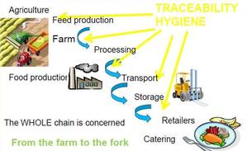
Food-specific legislation related to traceability

Slide 112
Thanks you for your attention!

